Slide 1

Mafia and Connected Cells
Course Title: Algorithm Lab​
Course Code: CSE-208
Course Section: 232_D5
Presented to,​
Md. Abu Rumman Refat
Lecturer
Green University of Bangladesh
Presented by,​
Md. Shajalal​
223002088

Slide 2
Content
Mafia Problem
Summary
Diagram of Problem
Find Solution
Connected Cells
Application
Input/Output
Implementation

Slide 3
1219: Mafia
Describe
Don Seliari gives his right hand Tommas Angelo (Tommy) an important job to guard his territory. The mafia territory consists of n cities. And the cities are connected to each other in such a way that there is exactly one path from any city to another. Tommy has exactly n mafia boys to guard the cities. Initially the mafia boys are resting randomly at the n cities. Tommy wants every city to be guarded by the mafia boys. This is to be accomplished by a sequence of moves; each move consists of moving one mafia boy to the adjacent city. What is the minimum number of moves required so that every city is guarded?

Slide 4
Summary of Problem
Problem Statement:
Scenario: Don Seliari assigns Tommy the task of guarding his mafia territory.
Territory: The territory consists of 'n' cities connected in a tree-like structure (meaning there's only one unique path between any two cities).
Guards: Tommy has exactly 'n' mafia boys to guard these cities.
Initial Placement: The mafia boys are initially scattered randomly across the 'n' cities.
Objective: Tommy needs to find the minimum number of moves required to ensure that every city is guarded by a mafia boy.
Move Definition: A move involves shifting one mafia boy from his current city to an adjacent city

Slide 5

Problem Diagram
1
2
3
4
5
6
7
8
9

Slide 6
Input / Output Format
Input Format:
T: Number of test cases (1 ≤ T ≤ 10).
For each test case:
n: Number of cities (1 ≤ n ≤ 10000).
City Information:
v: City ID.
Number of mafia boys at city 'v'.
d: Number of cities adjacent to city 'v'.
List of adjacent cities (excluding the one connected to the root).
Output Format:
For each test case:
Print the case number.
Print the minimum number of moves required to guard all cities.

Slide 7
Input / Output
Input | Output
1 9 1 2 3 2 3 4 2 1 0 3 0 2 5 6 4 1 3 7 8 9 5 3 0 6 0 0 7 0 0 8 2 0 9 0 0 | Case 1: 7

Slide 8

Solution
Minimum Steps
Step 1: Node 4 → Node 9
Step 2: Node 8 → Node 4
Step 3: Node 4 → Node 7
Step 4: Node 1 → Node 4
Step 5: Node 5 → Node 3
Step 6: Node 3 → Node 6
Step 7: Node 5 → Node 3
1
2
3
4
5
6
7
8
9
Total Minimum Steps: 7 (answer)

Slide 9
Connected Cells in a Grid
Given a 2D matrix of 0s and 1s, where 1 represents a filled cell, find the size of the largest connected region of 1s. Connections are allowed horizontally, vertically, and diagonally.
The goal is to determine the size (number of cells) of the largest region formed by connected filled cells (1s) in the grid.

Slide 10

Application
Image Processing & Computer Vision
Satellite Imaging & Land Use Classification
Medical Imaging (e.g., MRI, CT scans)
Artificial Intelligence & Game Development
Disaster Mapping (e.g., Forest Fire Spread Simulation)
Network Reliability & Cluster Detection
Puzzle Solving & Logical Games

Slide 11
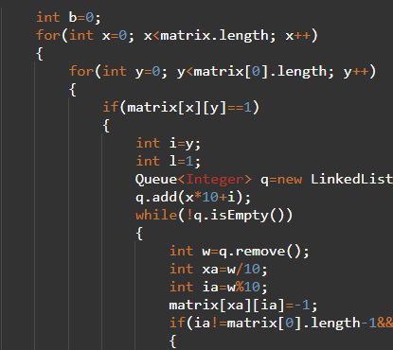
Implementation
We use Breadth-First Search (BFS) to explore all 8 directions from each filled cell. Each visited cell is marked to avoid reprocessing. We track and update the max size of connected regions.
Loop through each cell in the matrix.
On finding a '1', trigger BFS to find the connected region.
Use a Queue to traverse all adjacent (8-directional) '1' cells.
Track the largest region found during traversal.

Slide 12
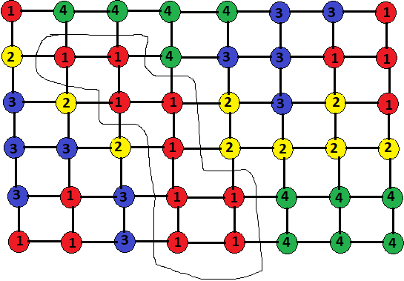
Input / Output Format
Constraints: 0 ≤ m, n ≤ 10
Input: Number of row Number of column For each test row, column: Dimensions of the grid (m, n) | Output: One Integer

Slide 13
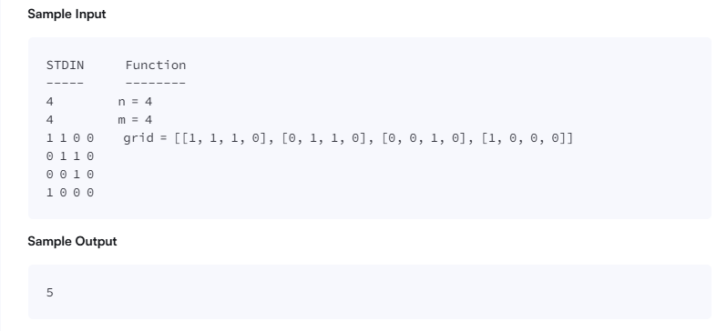
Input / Output

Slide 14
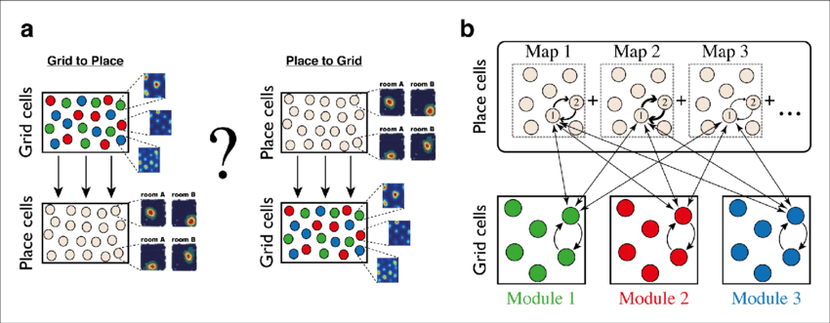
Discussion
This project demonstrates effective use of graph traversal (BFS) to solve matrix-based region connectivity problems. It enhances algorithmic understanding and builds problem-solving skills.

Slide 15
Conclusion
The problem enhances understanding of grid-based algorithms, graph traversal, and real-life applications of BFS. It is a practical demonstration of region detection using Java.

Slide 16
Q&A

Slide 17
Thank You

